Slide 1
Education, Screening, & Outreach
UK Markey Cancer Center
Melissa Hounshell, Community Outreach Director

Slide 2

Outreach Program Overview
In late March 2014, we sharpened our focus with hopes of developing an improved outreach program.
Markey Cancer Center is committed more than ever to leading a comprehensive cancer screening, education, prevention, and outreach program that serves the citizens of the state. Given the high-incidence rates of cancer, the program has a particular focus on Eastern Kentucky while also serving people statewide.
We work collaboratively with existing cancer education programs, community leaders, and our Markey-affiliated partners to further cancer prevention and education.
Our ultimate goal is simple: save lives.

Slide 3
Screenings
  Breast
      We have had three Saturday breast cancer screening events (August, November, March). We are targeting uninsured, underinsured, or insured women who can’t get screened M-F.
  Colon
      We are working very closely with the Kentucky Colon Cancer Screening Program and Kentucky Cancer Link to identify those who should be screened. We are taking the FITs to various health fairs as we try to educate the public and healthcare community about the tests.
  Skin
      We are hoping to offer 1-2 skin cancer screening events in the next year. We will work with community dermatologists to hold an event in the Lexington area and another in a rural community.
  Lung
    We are working collaboratively with Markey’s Lung Cancer Screening Program coordinator, navigator, and researchers to promote and educate the public about low-dose CT screenings. Screenings are expected to start anytime.

Slide 4
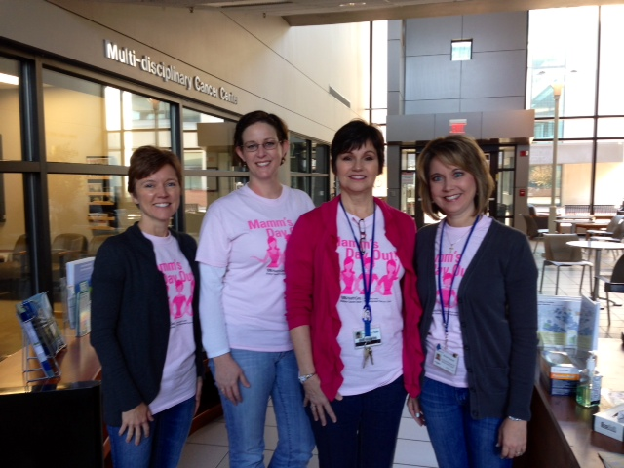
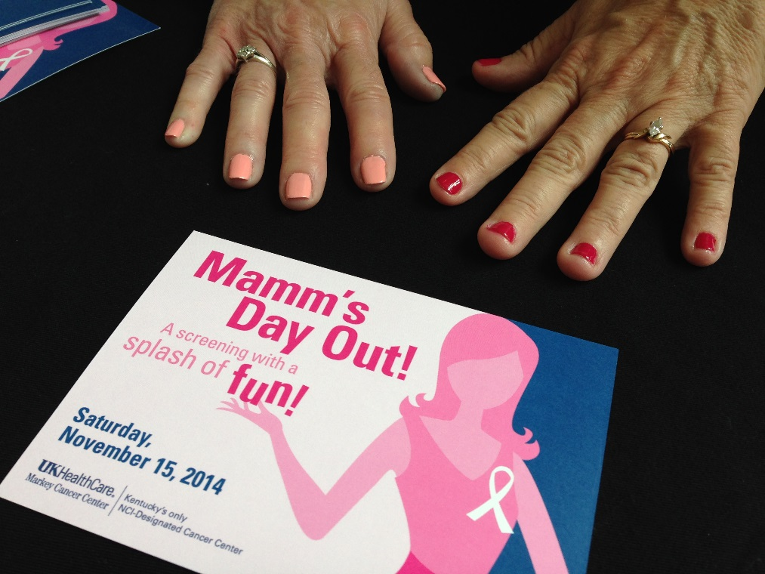
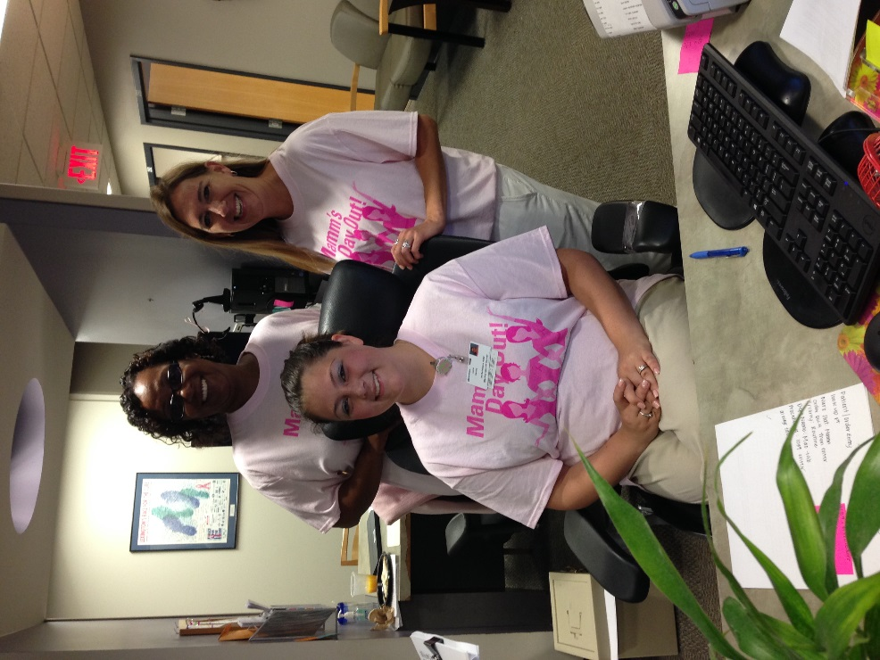
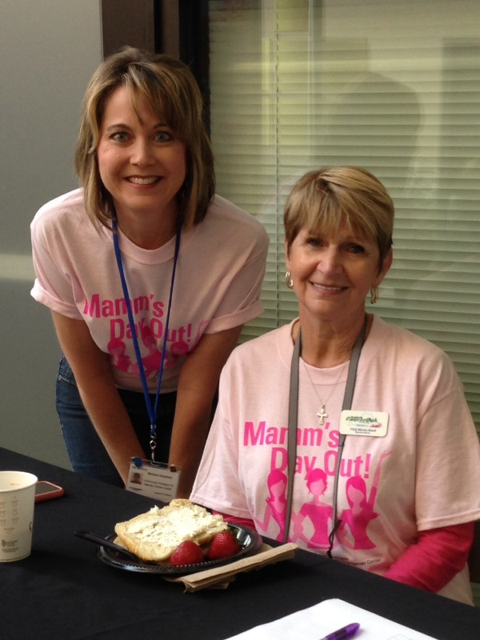

UK Markey Cancer Center’s
Mamm’s Day Out!
August, November, March events
Markey Comprehensive Breast Care Center
Saturday screenings
8am-1pm
45 women screened
7 called back for diagnostics
Targeting uninsured, underinsured, and insured ladies who can’t get a screening M-F

Slide 5
Challenges
Expanded Medicaid
Fewer attendees at events
Screenings are now covered
Confusion of where to start with care
Some are not receptive to education

Slide 6
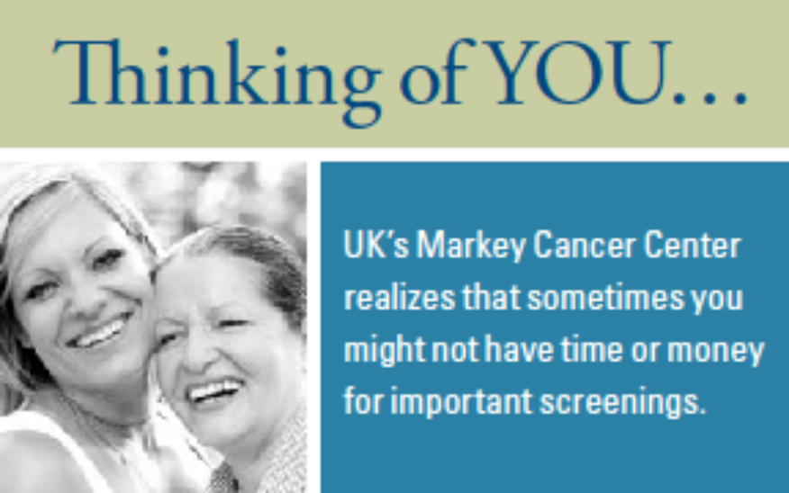



Sample cards for outreach and screenings

Slide 7
Educational/Screening Snapshot:
March 2014-date:
      St. Claire Women’s Health Fair 100 each event Apr ’14 & Apr ‘15
      Purses, Pouts & Pearls 250 (cards) 5/9/14
      Bell-Whitley Co. Health Fair 100 attendees 6/6/14
      Harrison Co. Health Fair 350 attendees 6/18/14
      Magoffin Co. Lakefront Church of God 500 attendees 7/23/14
      Mamm’s Day Out (3 events) 45 women screened Aug 2014-date
      Leukemia & Lymphoma Society 8,000 screening cards Ongoing
                Distributing cards throughout Eastern KY
      UKHC Marketing (Screening cards) 5,000 screening cards Ongoing
      Various businesses, schools, individuals (cards) Approximately 3,500 Ongoing
              Dairy Queen, Lee’s Famous Recipe, Kentucky Farm Bureau, Clark Co. Schools, Montgomery Co Schools
      Go Pink Event/Rowan County 120 attendees 10/22/14
      Fayette Co. Senior Citizens 25 attendees 10/23/14
      Clark County Community Services 150 attendees 10/27/14
      KSU Health Fair/Frankfort 200 attendees 10/28/14
      South Magoffin Health Day/Salyersville (2 events) 100 attendees Nov ‘14 & Apr ‘15

Slide 8
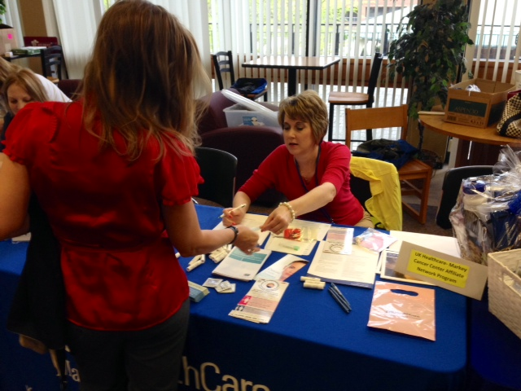
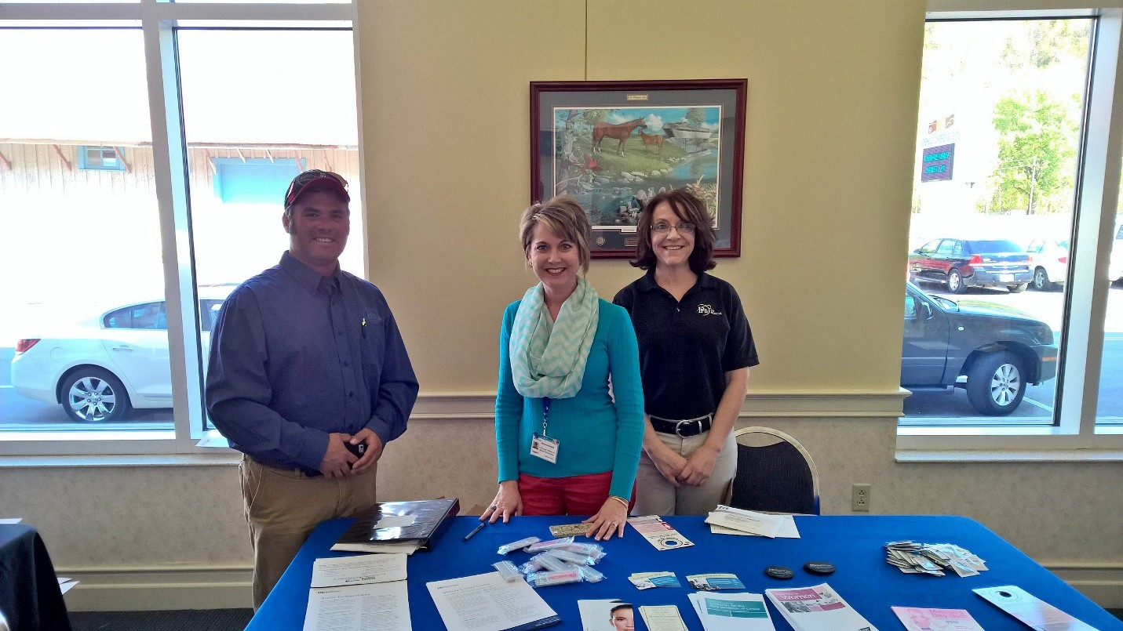
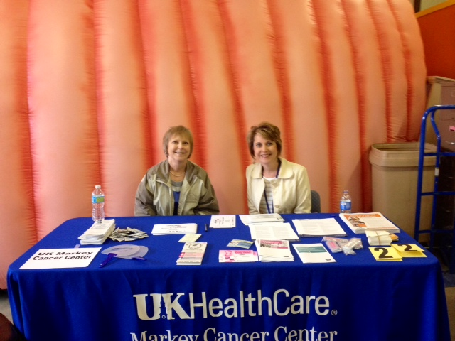
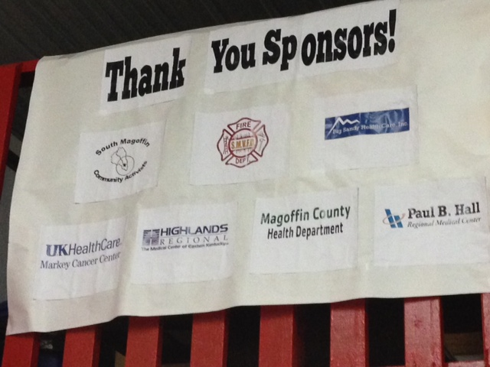
Outreach & Education
EKU Health Fair
Richmond
April 15, 2015
Partnered with UKHC Marketing
St. Claire Women’s Health Fair
Morehead
April 29, 2015
Approximately 100 attended
Distributed free FITs
South Magoffin Spring Health Day
April 30, 2015
Salyersville
Partnered with community hospitals and providers
Distributed free FITs

Slide 9
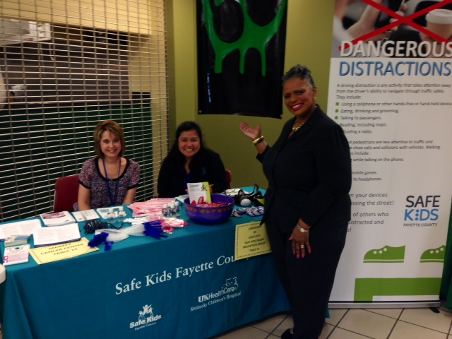
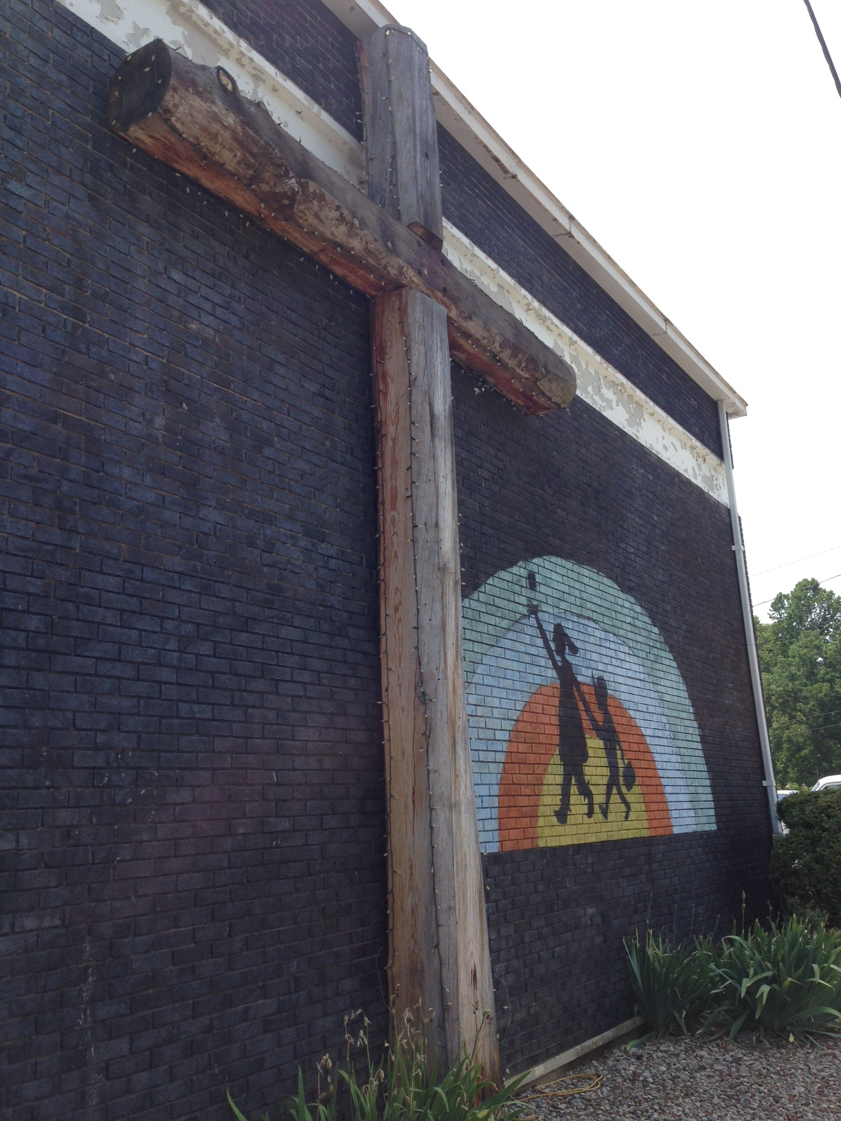
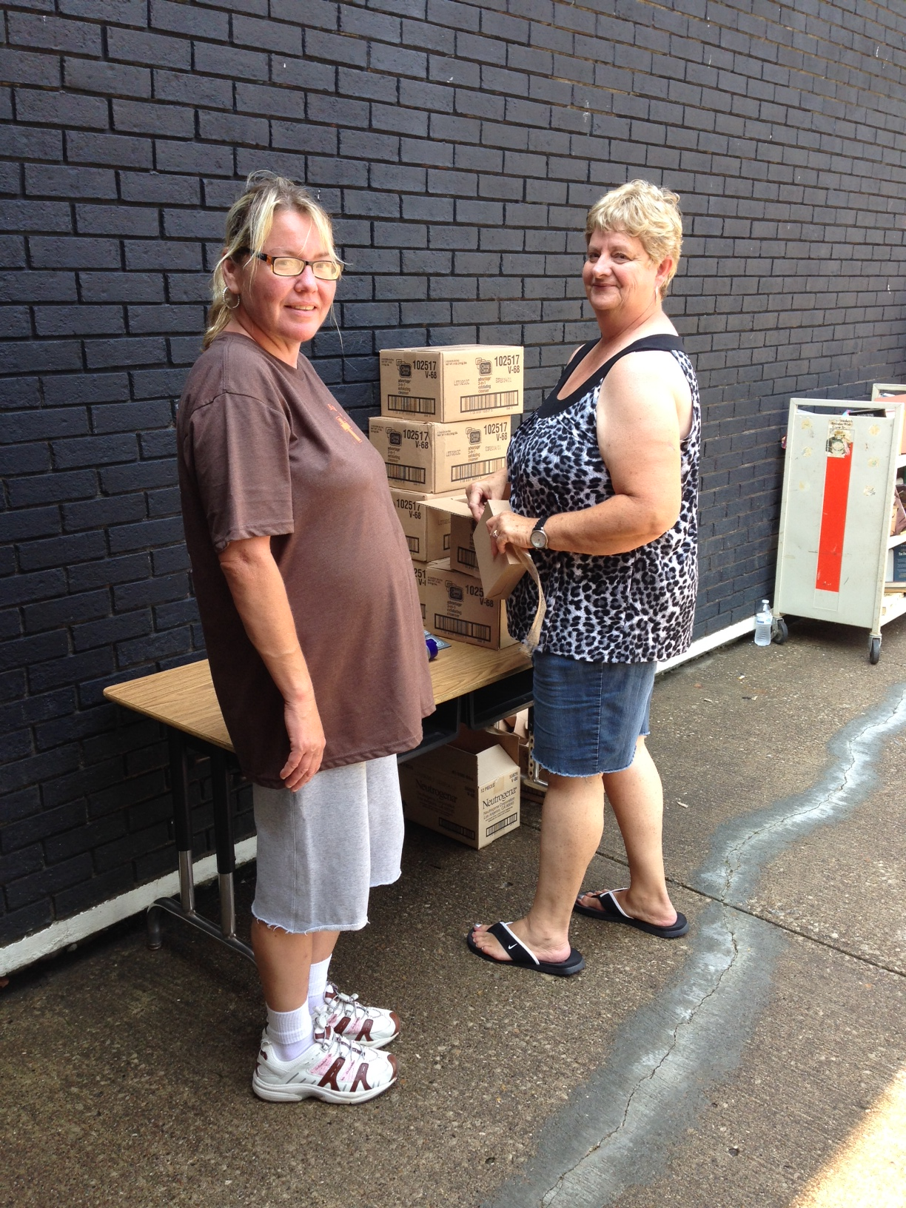
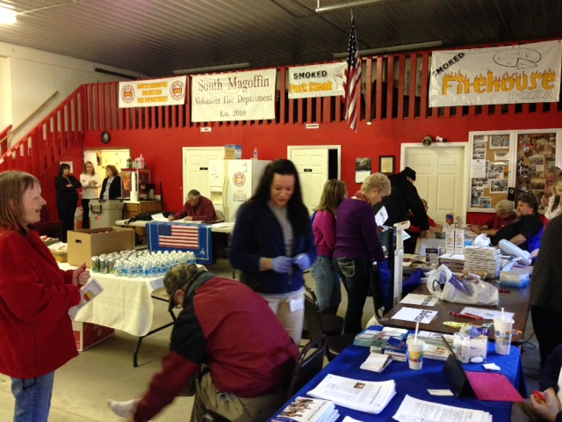
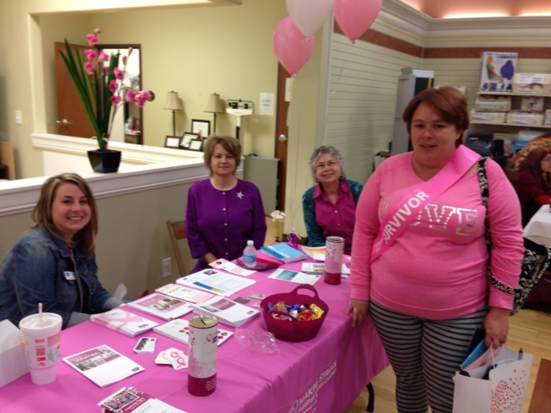
Outreach & Education
KSU Health Fair
Frankfort
October 28, 2014
Partnered with Safe Kids Fayette Co.
Go Pink Event
St. Claire Regional
Morehead
October 22, 2014
Lakefront Church of God, Magoffin County
Food distribution center
July 23, 2014
500-600 attended
South Magoffin Health Day
November 20, 2014

Slide 10
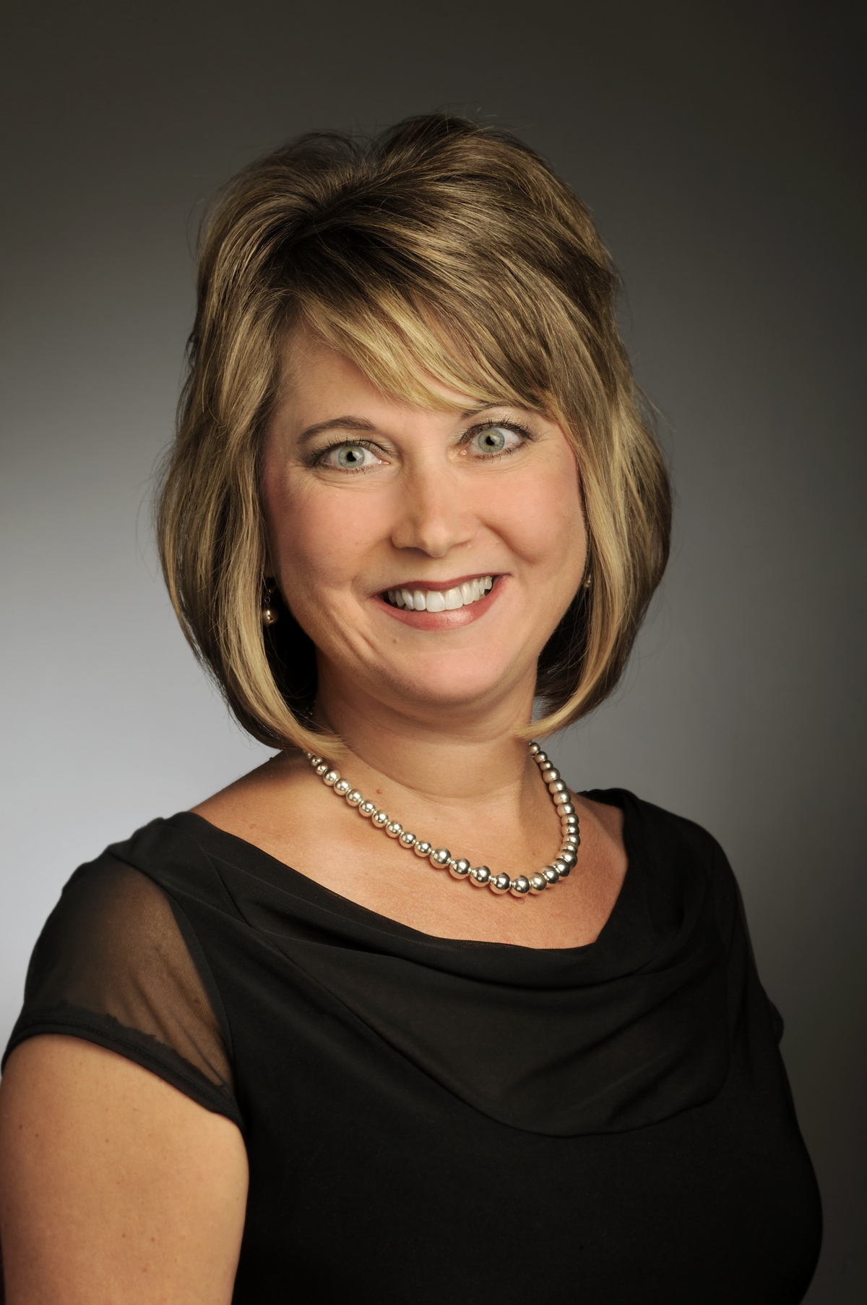

Contact Information:
Melissa Hounshell
Community Outreach Director
UK Markey Cancer Center
800 Rose Street, 313 Combs
Lexington, KY 40536
859-494-7953 (cell)
859-323-2034 (office)
Melissa.Hounshell@uky.edu

